Slide 1

Comparing to human-level performance
Why human-level
performance?
deeplearning.ai

Slide 2
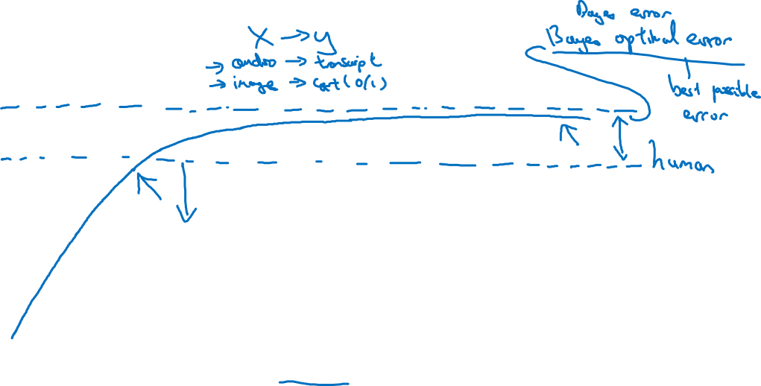
Comparing to human-level performance
accuracy
time

Slide 3
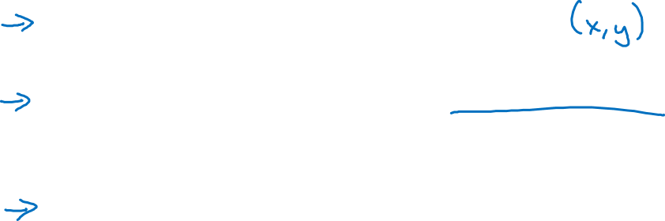
Why compare to human-level performance
Humans are quite good at a lot of tasks. So long as ML is worse than humans, you can:
Get labeled data from humans.
Gain insight from manual error analysis: Why did a person get this right?
Better analysis of bias/variance.

